Slide 1
FinSecure Fintech Solution's
Driving Financial Prosperity with Expertise & Integrity
A Legacy of Trust….

Slide 2
Agenda
01
02
03
04
05
06
About Us
Mission Vision Goals Team Contact

Slide 3
About US
FinSecure Fintech Solutions is a Pioneering firm Specialized in Asset based Collection’s & Repossession Services tailored for Non-Banking Financial Companies (NBFCs), Banks & ARC’s.
Particularly in write-off cases.
Leveraging cutting-edge Fintech solutions with team of Seasoned professionals.
We are committed to maximizing Asset Recovery for Our clients while upholding the highest standards of Compliance and Integrity.
We also committed to reshaping the landscape of Asset Recovery in the Financial Sector

Slide 4
Our Values
Integrity
Passion
Profitability
Result
Trust

Slide 5
Vision
Driving Financial Prosperity with Expertise & Integrity
01
Transforming Debt Collection with Innovation ,Reliability.
02
Aim is to be the Prominent Asset based Collection Agency.
03
Driving Financial Recovery through ethical practices.
04
Cutting Edge technology.
05
Unwavering commitment to client success.

Slide 6
Mile stone
1996 2006 2016 2023 2024
Started with Single MAN
Worked for Escort Finance,
Kinetic Fincorp
Close to 300 + assets were repossessed
HDFC Bank
Tata Motors
Chola , Citicorp , Shriram Tpt
Close to 600 + assets were repossessed
Mahindra Finance , Tata Capital , Magma , Religare , Reliance Capital, Kotak Mahindra Bank , Sundaram.
Close to 1300 + assets were
L&T Finance , Daimler IKF , India Infoline , HDB , Manappuram , Tata Motors
Even in Covid Time we repossessed close to 450 + assets
Elevated from Proprietor to PVT LTD
FinSecure Fintech Solutions

Slide 7
Clients

Slide 8
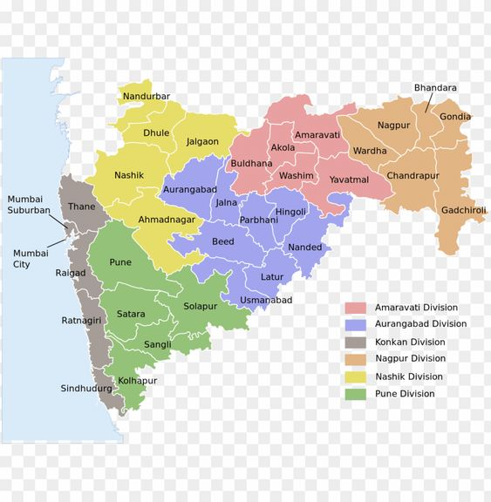
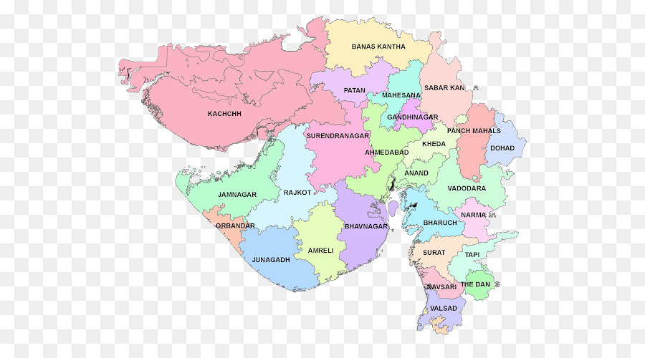
Our Present Goals
Maharashtra
Gujarat

Slide 9
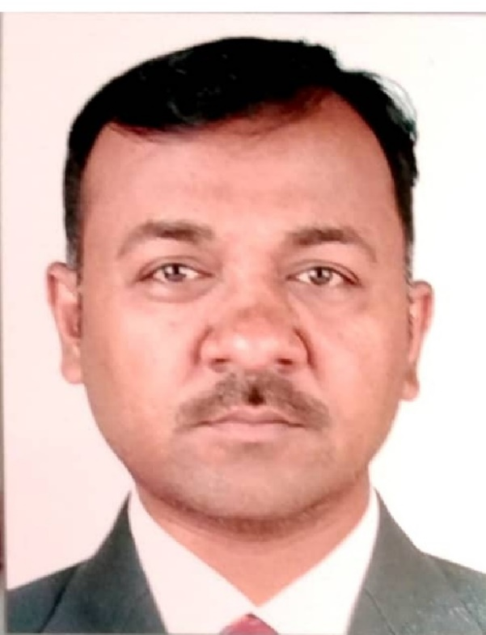
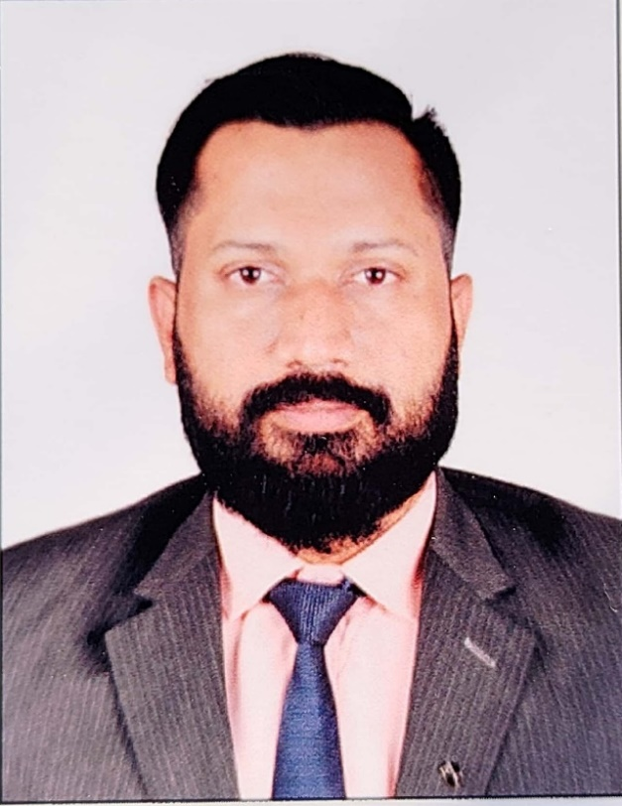
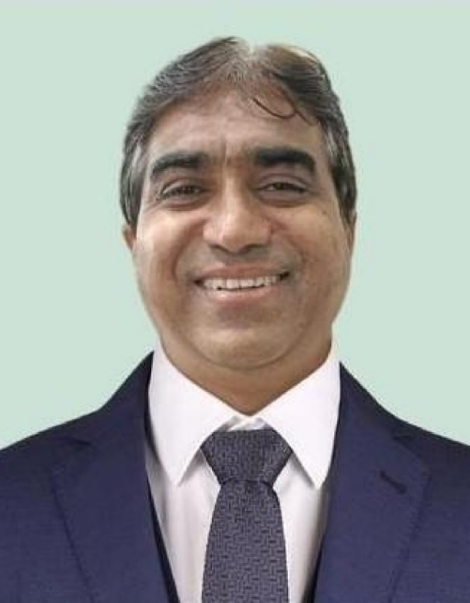
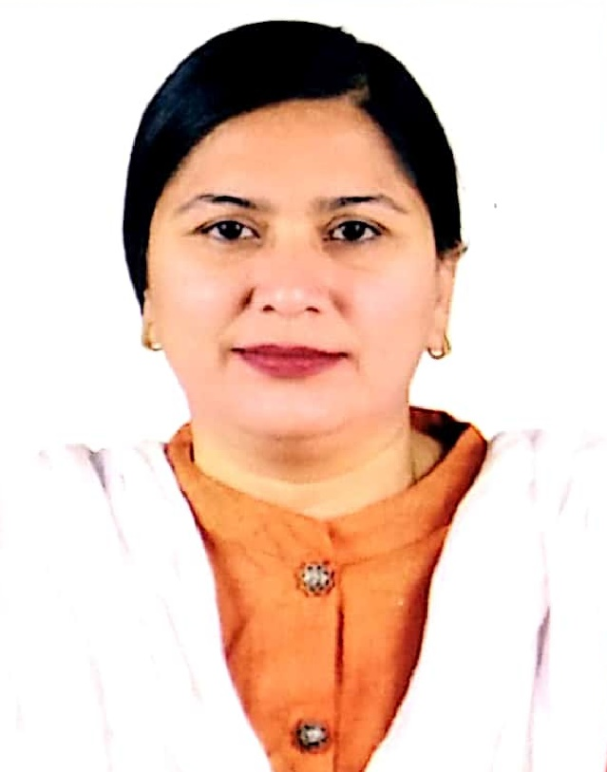
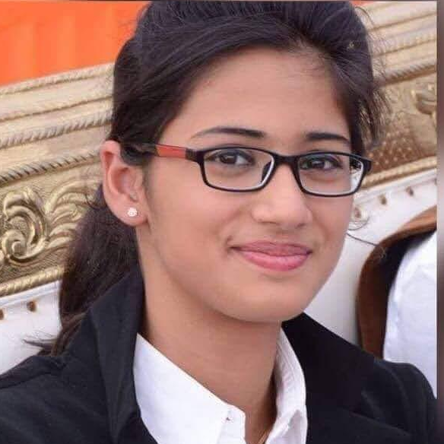
Our Management Team
Saleem Rana
Asif Siddiqui
Shakeel Nadaf
Farhana Siddiqui
Maryam Siddiqui
CEO
CFO
COO
CAO
CLO

Slide 10
Thank You!
FinSecure
Fintech
Solutions
Contact Us
Everest Cantu
9699740443
Connect@Finsecurefintech.com
MumbaiHO@Finsecurefintech.com
www.Finsecurefintech.com
Mira Road Mumbai - 401107

